Slide 1
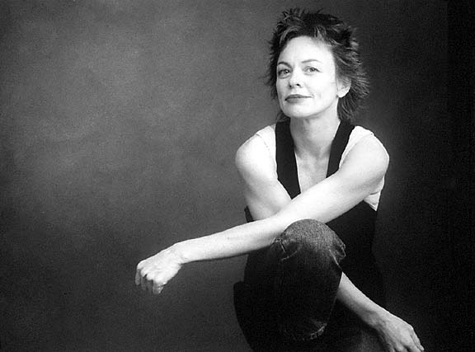
Laurie Anderson
Experimental performance
artist, composer and
musician

Slide 2
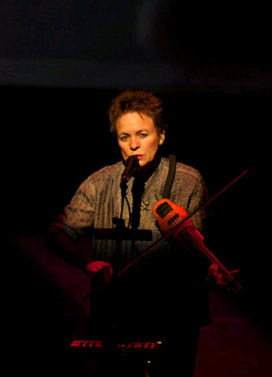
The work and her inspiration
She has cast herself in roles as varied as visual artist, composer, poet, photographer, filmmaker, electronics whiz, vocalist, and instrumentalist.
Her work reflects the world in its melancholy, disjointed, mesmerizing glory.
“But my goal as an artist isn’t to change the world.
My goal is to describe it” Laurie Anderson

Slide 3
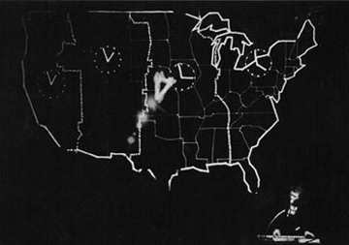
United States
Covered themes such as transportation, politics, money and love.
When I began to write United States, I thought of it as a portrait of a country. Gradually I realised it was really a description of any technological society and of peoples attempts to live in an electric world. – Laurie Anderson
A performance in response to her friends, who asked how she could live in a high tech cultural wasteland like America

Slide 4
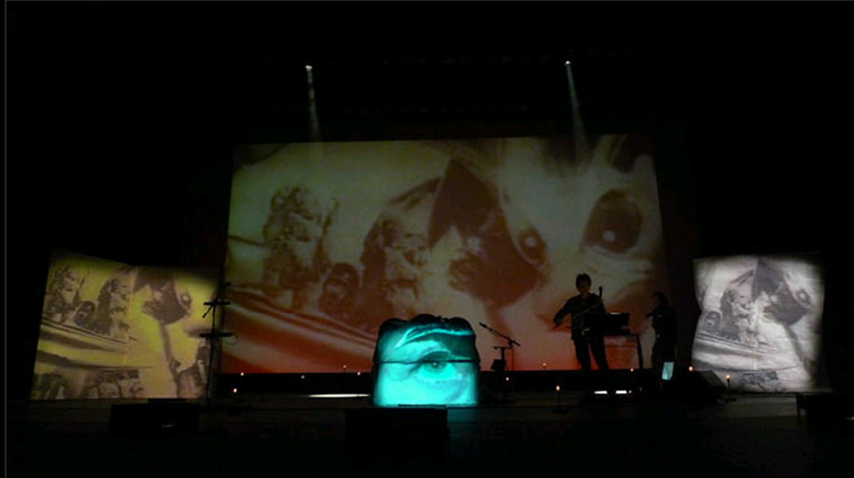
Happiness, The end of the Moon, Dirtday
Trilogy of work
Explores themes of politics, history and dreams.
Blends sound and movement, image and spoken word in immersive, dreamlike productions.
Idea for Dirtday originally started with the exploration of her violin until other sounds and words were added and the violin then supported the stories told.
http://www.youtube.com/watch?v=KYisa36ODW8

Slide 5
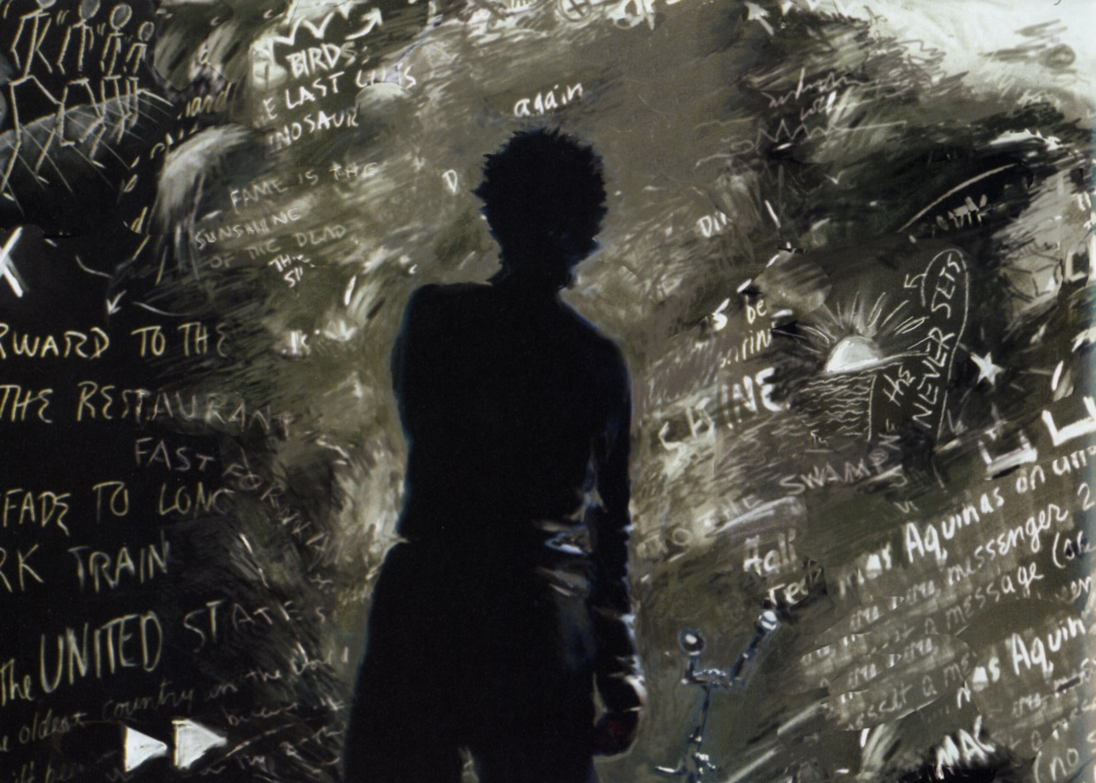
No matter the gravity of her larger themes, she always began with the ordinary, the familiar; from there her idea’s fanned out, like a web that became more intricate, more diaphanous and dreamlike at the edges (Goldberg, 2000, p.87)
One of my jobs as an artist is to make contact with the audience and it has to be immediate (Anderson in Goldberg, 2000, p.11)
She had utilized a variety of media with ease and invented a repertory of her own. She had sashayed between disciplines, creating seamless borders by frequently crossing them (2000, p.12).

